Slide 1
Chapter 17
Making Decisions about Computers, Information, and Society

Slide 2
Learning Objectives (1 of 2)
Use ethical reasoning to evaluate social issues related to computing
Understand the issues involved in digitally sharing copywritten intellectual property, such as music, videos, photographs, books, and video game software
Discuss trade-offs between the rights of personal privacy and governments' concerns with safety and security
Provide arguments that support and oppose hackers who claim to be performing a social good

Slide 3
Learning Objectives (2 of 2)
Describe cyberbullying and why legal remedies are so difficult to apply
Explain the potential dangers that have arisen from the enormous growth of social media
Discuss how social media makes it easier to globally disseminate rumors and false information that can have a profound effect on governments worldwide

Slide 4
Introduction
Social and ethical issues related to information technology are unavoidable
Just because we can, doesn’t mean we should
Develop skills to reason about such issues
Learn about morality and ethics in the digital space
Case studies introduce important ethical issues
Describe arguments for and against certain positions
Evaluate arguments in terms of ethics

Slide 5
Case Studies Case 1: Is Sharing Good? (1 of 8)
Napster file-sharing system was developed (1999)
Peer-to-peer file sharing
Software introduces users to each other
Sharing happens directly between users
Recording companies filed suit against Napster, 1999
Lawsuit claimed Napster was a conspiracy to encourage mass infringement of copyright

Slide 6
Case Studies Case 1: Is Sharing Good? (2 of 8)
Facts
Most shared music was copyrighted
Many artists opposed sharing—no revenue for them
Some artists supported sharing
Napster claims
Napster reported song locations, not involved in actual sharing
They were not responsible for users’ behaviors
Swapping files this way should be “fair use” under copyright law

Slide 7
Case Studies Case 1: Is Sharing Good? (3 of 8)
Napster lost the case and appeals, and closed in 2001
Sharing movies, legally or not, is a growing issue
Downloading images from the web for personal use
Ethical (not legal) questions
Is it right to swap copyrighted music files?
Is it right to provide a search engine to enable users to search each other’s databases for copyrighted materials?

Slide 8
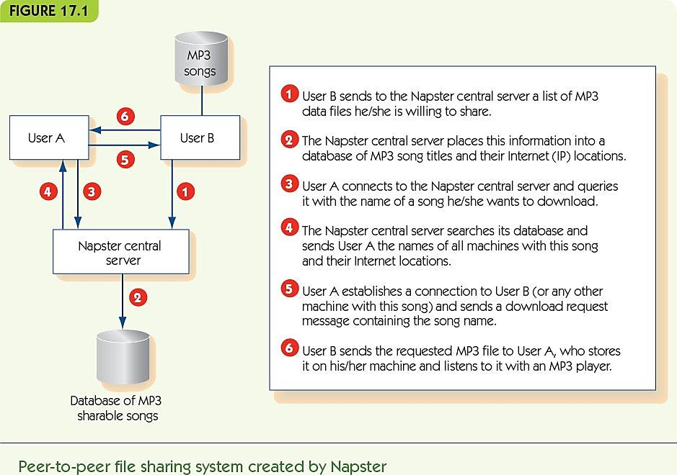
Case Studies Case 1: Is Sharing Good? (4 of 8)

Slide 9
Case Studies Case 1: Is Sharing Good? (5 of 8)
Ethics: the study of how to decide if something is morally right or wrong
How do we judge right or wrong?
Consequentialism focuses on the consequences of an act—on the whole good or bad outcomes
Utilitarianism: look at overall good for everyone

Slide 10
Case Studies Case 1: Is Sharing Good? (6 of 8)
Utilitarian argument #1: copying is OK
There are many more music users than publishers
Music users are happy to get free access
Publishers get publicity for their products
File sharing is akin to hearing a song on the radio
Many users buy a song after listening to it
Drop in sales may relate more to purchasing song-by-song rather than by album

Slide 11
Case Studies Case 1: Is Sharing Good? (7 of 8)
Utilitarian argument #2: copying is not OK
Early on MP3 sharing encouraged CD sales, but long-term trend is reduction in sales
iTunes and Amazon sell one song at a time to compete with illegal file sharing
If publishers cannot profit, then less music will be made
Copyright protection is the law, and music file sharing is clearly illegal; encouraging illegal behavior is wrong

Slide 12
Case Studies Case 1: Is Sharing Good? (8 of 8)
Dialectic: a dialogue that explores an issue from both sides to lead to greater understanding
An example:
Facts are that music sales have dropped continuously
Long-term, argument that less music would be published is a strong one
Lesser-known artists may use file sharing to become better known, depend on income from performances
Rethink the music industry from a new viewpoint

Slide 13
Case Studies Case 2: The Athens Affair—Privacy vs. Security (1 of 12)
Law enforcement needs to wiretap phones belonging to suspects
Prior to cellular technology, a wiretap was a literal split off the main phone wire into the building
Modern use of cell phones and VoIP complicates phone taps
However, most/all phone calls go through computer systems
Laws require all telecommunications to support “lawful intercept” (LI) systems for wiretaps

Slide 14
Case Studies Case 2: The Athens Affair—Privacy vs. Security (2 of 12)
Built-in LI systems are a target for hackers
In Greece, hackers wiretapped 100 major business and political leaders
No trace of who did it or why
Ethical question
How does the decision to require LI software impact privacy and security?

Slide 15
Case Studies Case 2: The Athens Affair—Privacy vs. Security (3 of 12)
Ethical reasoning by analogy
Analogy-making is familiar to everyone
Analogies are never perfect: what aspects are important?
Apply decisions from one problem to another
Identify what doesn’t fit; often an important aspect of the problem

Slide 16
Case Studies Case 2: The Athens Affair—Privacy vs. Security (4 of 12)
Analogy #1: LI is like requiring everyone to record their face-to-face conversations
Focused on VoIP (e.g., Skype)
Similarities between VoIP and face-to-face
Forms of communication
Meant to include a limited number
Possible for others to listen in
Easy access for others; required recordings allow abuses by government or hackers

Slide 17
Case Studies Case 2: The Athens Affair—Privacy vs. Security (5 of 12)
Decisions about face-to-face conversations
Private conversations are not monitored routinely
Monitoring only with court order and probable cause
We do NOT record all conversations all the time
Implications by analogy for VoIP
LI systems go beyond rules for private conversations
Without LI, law enforcement can still monitor as with face-to-face conversations

Slide 18
Case Studies Case 2: The Athens Affair—Privacy vs. Security (6 of 12)
Problems with the analogy
This argument would apply to normal phone tapping
Society accepts the need for some phone taps
What features of the analogy don’t work?
Fourth party involvement: telecommunications provider
An analogy that includes a middleman is needed

Slide 19
Case Studies Case 2: The Athens Affair—Privacy vs. Security (7 of 12)
Analogy #2: LI is like suspicious activity reporting (SAR) in banking
U.S. banks must notify government when they see suspicious transactions
Similarities between LI and SAR
Both are critical resources for criminals and require the help of external (law-abiding) entity
Information helps to connect suspects with each other and discover networks of suspects

Slide 20
Case Studies Case 2: The Athens Affair—Privacy vs. Security (8 of 12)
Problems with the analogy
Who initiates the sending of information differs (banks initiate, not government)
The information provided is very different
Banks provide times, dates, and participants
Full conversation recording supplies much more detail

Slide 21
Case Studies Case 2: The Athens Affair—Privacy vs. Security (9 of 12)
Decision about suspicious activity reporting
Banks should be required to report suspicious activity
Implications by analogy
Telecom companies should be required to report suspicious activity
Supports storage of detailed call records
Does not support storage of whole conversations

Slide 22
Case Studies Case 2: The Athens Affair—Privacy vs. Security (10 of 12)
After analyzing the analogies, consider three possible options/solutions:
Require all VoIP systems to implement LI
Do not require LI; use physical eavesdropping
Require VoIP providers to report suspicious activities, but do not record conversations

Slide 23
Case Studies Case 2: The Athens Affair—Privacy vs. Security (11 of 12)
Interested parties
Law enforcement
Monitoring saves time and money; can do job better
Hackers and non-hacker criminals
The public
Monitoring helps law enforcement, but decreases privacy and perhaps safety

Slide 24
Case Studies Case 2: The Athens Affair—Privacy vs. Security (12 of 12)
Utilitarian analysis
Law enforcement
Option 1 is best
The public
Option 2 reduces police effectiveness
Option 1 allows for abuses
Option 3 may also reduce police effectiveness

Slide 25
Case Studies Case 3: Hackers—Public Enemies or Gadflies? (1 of 8)
Hackers: people who break into computer systems, launch Internet worms and viruses, vandalize web sites, etc.
Some hackers are clearly criminals
Purposeless vandalism
Identity theft
Outright theft
Some hackers engage in “hacktivism”
Can hacking a computer be a social good?

Slide 26
Case Studies Case 3: Hackers—Public Enemies or Gadflies? (2 of 8)
WikiLeaks
Protects government and corporate whistle-blowers
Provides a secure way to share sensitive documents anonymously
Video of U.S. firing on Reuters employees
U.S. diplomatic cables
One million confidential/secret U.S. government documents
WikiLeaks is a public corporation with known leadership

Slide 27
Case Studies Case 3: Hackers—Public Enemies or Gadflies? (3 of 8)
Anonymous
Primarily interested in freedom of speech
No official leader or organizing body
Amorphous, secret membership
DOS attack in retribution for sanctions against WikiLeaks
Attacks on government sites in Tunisia, Egypt, Libya
Publication of emails from corporations

Slide 28
Case Studies Case 3: Hackers—Public Enemies or Gadflies? (4 of 8)
Analogy: breaking into a computer is like breaking into someone’s house
Similarities
Intruders are there without permission
Owners take precautions to discourage intrusion
Both are against the law
Differences
Burglars take physical objects, depriving owner
Hackers, in this case, copy intellectual property
No threat of violence with hacking

Slide 29
Case Studies Case 3: Hackers—Public Enemies or Gadflies? (5 of 8)
Utilitarian arguments
Owner of information loses control over it
Hacker gains access to information
Owner must increase security
Increased awareness of vulnerability may be good
Increased security only required because of hackers
Hard to see consequences
Must we distinguish between “good hackers” and “bad hackers”?

Slide 30
Case Studies Case 3: Hackers—Public Enemies or Gadflies? (6 of 8)
Deontological arguments
Deontology: the study of duty and obligation
Focus on duties of actor and effect on other’s rights
Categorical imperative (Kant):
Never treat a fellow human merely as a means to an end
Focus on intent of an action, not consequences
Hackers for personal gain are unethical; ignore them
Focus on hackers who claim benign intent

Slide 31
Case Studies Case 3: Hackers—Public Enemies or Gadflies? (7 of 8)
Parts of the hacker ethic (Steven Levy):
“All information should be free”
To make decisions, people need good information
Hackers should always spread information
“Mistrust authority—promote decentralization”
Bureaucracies and rules prevent things from getting done
Each hacker should act individually as he or she sees best

Slide 32
Case Studies Case 3: Hackers—Public Enemies or Gadflies? (8 of 8)
Ethical critique of hacker ethic
The information being shared does not belong to the hacker
Does not respect other people’s wishes or safety
Rules exist because we, as a society, expect electronic privacy
Why should their ethic override other people’s wishes?
Does hacking treat other people as a means to an end?

Slide 33
Case Studies: Thinking Straight about Technology and Ethics
“Paramedic ethics:” know a little and know when to ask
Ask these questions when facing an ethical problem:
Who are the stakeholders in this situation?
What does each stakeholder have to gain or lose?
What duties and responsibilities are important?
Can you think of an analogous situation? Does it clarify the situation?
Make a decision or repeat in dialectic form

Slide 34
Case Studies Case 4: Genetic Information and Medical Research (1 of 7)
Fictional ethical situation
Family doctor asks you to participate in a study of genetic diversity and disease by donating some skin cells. Cells are identified by a randomly assigned number and your zip code. Should you donate?
Who are the stakeholders?
You
Family doctor
Pharmaceutical company, “PHARM CO”
Skin cell donors to study, in general
People with genetic disease

Slide 35
Case Studies Case 4: Genetic Information and Medical Research (2 of 7)
What is at stake?
You lose a few skin cells
Your privacy
PHARM CO may seek to learn your identity
Transmission of genetic data could be intercepted
Your doctor might be paid for finding participants
PHARM CO may develop new drugs
Drugs could help people with genetic diseases

Slide 36
Case Studies Case 4: Genetic Information and Medical Research (3 of 7)
Identify duties and responsibilities
Doctor has a duty to treat you and protect your privacy
You have a duty to pay the doctor and follow instructions
PHARM CO has a duty to develop safe drugs
PHARM CO has promised to pay doctors for finding participants
PHARM CO has promised to respect your privacy

Slide 37
Case Studies Case 4: Genetic Information and Medical Research (4 of 7)
More complex duties and responsibilities
Should you get royalties if your information leads to a profitable drug?
Does PHARM CO own genetic information, or should it be shared freely?
Why is zip code part of encoding?
Do you have a duty to help cure disease?

Slide 38
Case Studies Case 4: Genetic Information and Medical Research (5 of 7)
Think of analogies
Compare to Red Cross blood donations
Both involve confidential health information
Both ask for volunteer donors
Both have collectors and users who are paid
Both involve altruistic reasons for donation
Blood is the valuable item; genetic information in skin cells is the value
Company might or might not find usefulness in cells
Company is driven by profit and loss

Slide 39
Case Studies Case 4: Genetic Information and Medical Research (6 of 7)
Think of analogies
Compare to for-profit companies that solicit money for a charity
Confidentiality is an issue for both
In both, volunteers are asked to donate by someone with financial interest in the donation
Both involve altruistic motivations
One involves donated money; the other does not
Doctor and pharmaceutical roles don’t quite match for-profit company

Slide 40
Case Studies Case 4: Genetic Information and Medical Research (7 of 7)
Make a decision or loop again
Must you decide right now (while at the doctor)?
Should you do more research?
Should you ask others?
Might choose to decline unless you know more about PHARM CO’s use of your information, especially given the financial interests of other stakeholders

Slide 41
Personal Privacy and Social Networks (1 of 5)
Apply the reasoning from case studies to more personal ethical issues
Cyberbullying: humiliating, taunting, threatening, invading someone’s privacy online
Sexting: sending sexually explicit messages or images using cell phones or tablet computers
Privacy expectations for public postings to social networks

Slide 42
Personal Privacy and Social Networks (2 of 5)
Cyberbullying examples
Megan Meier committed suicide after being harassed on MySpace; harasser was the mother of a former friend
Information posted to Craigslist led to young girl receiving sexual phone calls and emails
Tyler Clementi committed suicide after his roommate posted a recording of a sexual encounter with another man
Laws lag behind the problem
First amendment protections complicate the issue

Slide 43
Personal Privacy and Social Networks (3 of 5)
Sexting between consenting adults is legal
Images intended to be private between two individuals may not stay that way
Once something is posted on the Internet, it is there forever
Sexting involving minors may be considered child pornography, even if the perpetrator is the “child”
Laws around minors sending other minors images have been relaxed in some states

Slide 44
Personal Privacy and Social Networks (4 of 5)
Privacy expectations with public postings online
Student posted nasty story on MySpace about her hometown; she deleted it six days later
Hometown high school principal saw the story, gave it to the local newspaper
Newspaper printed it as a letter to the editor
Family was threatened, lost business, had to move away
Courts found that she should have no expectation of privacy when making a public posting on MySpace

Slide 45
Personal Privacy and Social Networks (5 of 5)
Assume that anything sent or posted online:
May become widely distributed and public
Will last forever
Don’t post something if:
You don’t want a large number of people to see it
You would be embarrassed to have it widely circulated (to parents, employers, etc.)
The material could be considered libelous or defamatory
The information is private and of a sexual nature

Slide 46
Fake News, Politics, and Social Media (1 of 3)
Fake news is news deliberately altered or fabricated with the intent of passing it off as valid
Beware of the various types of fake news outlets
Imposter sites—mimic valid sites to spread fake news
Manipulated content—original content has been manipulated to fit the dialog of the posting site
Fabricated content—all of it is untrue

Slide 47
Fake News, Politics, and Social Media (2 of 3)
”Pizzagate” fake news during the 2016 election
Comet Ping Pong Pizza was said to be involved in a child pornography ring with presidential candidate Hillary Clinton and multiple members of congress
An individual with an AK-47 showed up threating to shoot anybody involved in child pornography in 2016
Determined to be fabricated in order to hurt the Clinton campaign

Slide 48
Fake News, Politics, and Social Media (3 of 3)
Verify sources when reading a story of interest online
Check the author
Check the supporting links
Who else is reporting it
Consider the intent of the story

Slide 49
Summary (1 of 3)
Computer technology intrinsically involves new social and ethical issues
Ethical reasoning provides a framework for analyzing ethical issues
Utilitarianism evaluates an act based on its consequences
A dialectic is a comparative discussion of opposing sides intended to clarify and improve understanding
Reasoning by analogy can clarify issues of an ethical problem

Slide 50
Summary (2 of 3)
Deontological reasoning focuses on intent rather than outcomes
Ethical issues with information technology include:
Copyright protections in an era of file sharing
Personal privacy and lawful intercept laws
Hackers who claim to be a social good
Privacy and the protection of personal information
Cyberbullying, sexting and distribution of online postings

Slide 51
Summary (3 of 3)
Be aware of the propagation of fake news
Pay close attention to it in politics
Find ways to limit your exposure to it
Stick to sources that you have verified and that are trustworthy
Always check sources and supporting links
Don’t believe everything you read without checking its validity first

